Slide 1
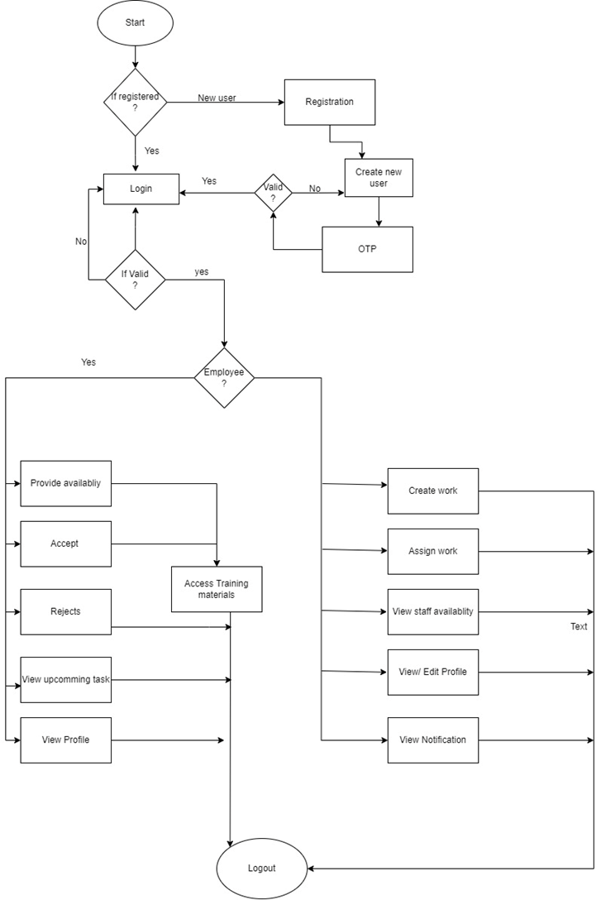
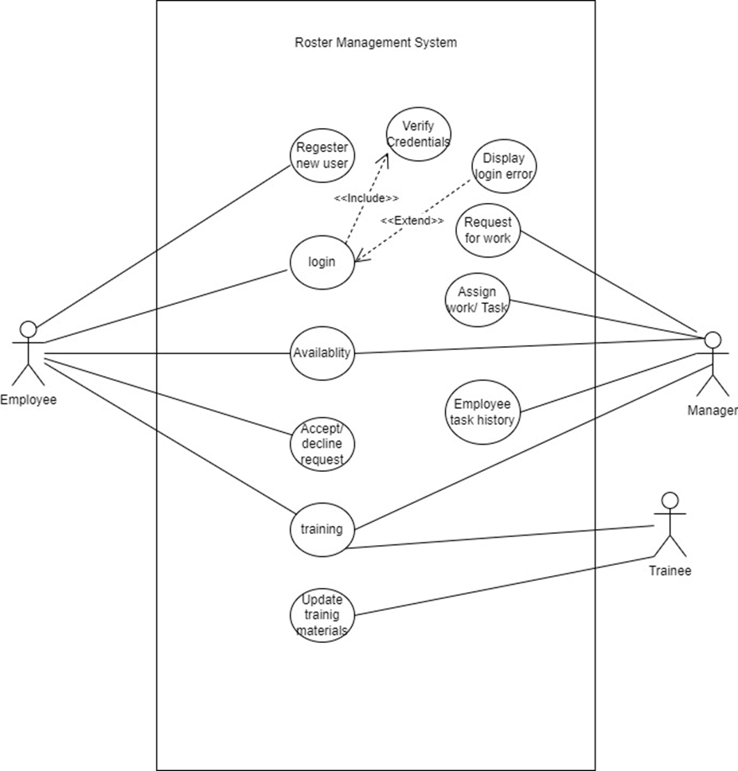
Proposed Design
1. System Perspective
External Perspective
Interaction Perspective
Structural Perspective
Behavioral Perspective
2. UML Diagram Type
Activity Diagrams
Use case diagrams
Sequence diagrams
Class Diagrams
State diagrams
Use Case Diagram
Behavioural Perspective

